Slide 1
Motion Graphs

Slide 2
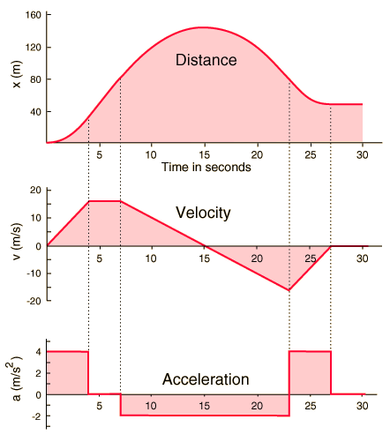
Motion-Time Graph
Describing motion is occasionally difficult to do with words
Graphs can help simplify this description greatly
  Position = Distance from a starting point
  Velocity = rate of change in position
  Acceleration = rate of change in velocity

Slide 3
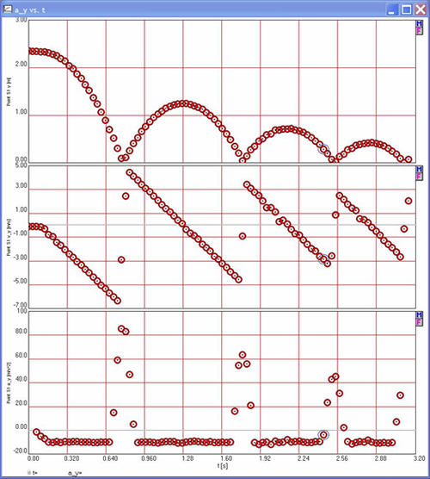
The Derivative and Integral
The slope of a curve has a physical meaning
  For a position-time graph
    y-axis measures meters (m)
    X-axis measures time (s)
  Slope is the rise over run (or Δy/Δx)
    This turns out to be m/s
  Slope is the derivative
The area under the curve has a meaning
  For a velocity-time graph
    y-axis measures velocity (m/s)
    X-axis measures time (s)
  Area for a square is L × W
    This means area is (m/s)×(s) which equals m
  Area under the curve is the integral
The text to the right of the red box is recommended, not required

Slide 4
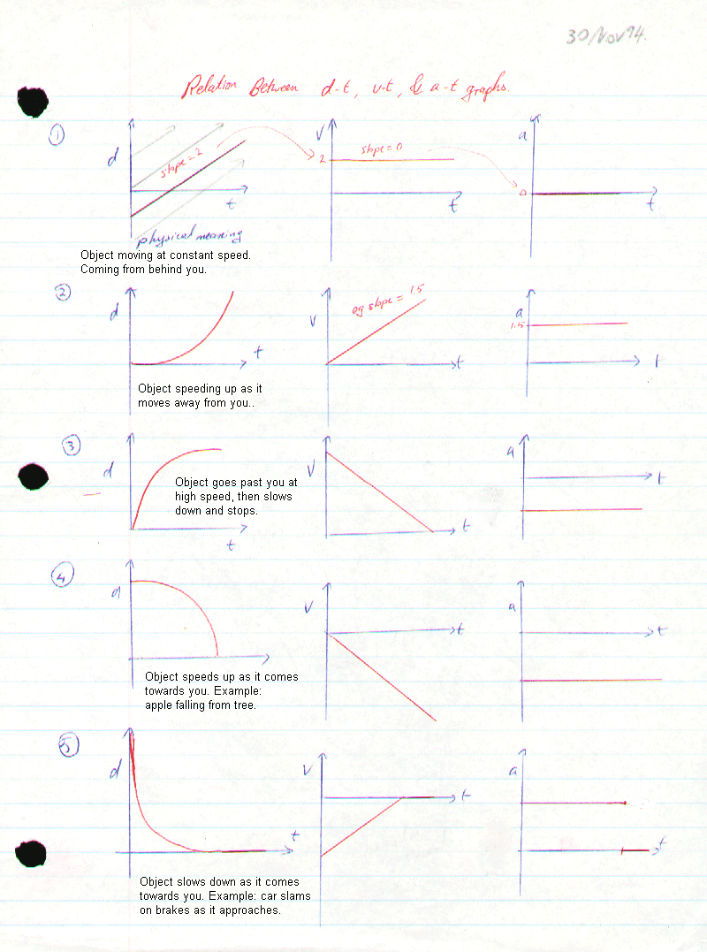
More examples
Check it out!

Slide 5
Motion type 1: Standing Still
X (t)
V (t)
a (t)
0
0
0
t
t
t
The object is in one location over time
The velocity must be zero
The acceleration must be zero

Slide 6
Motion type 2: Moving Away
X (t)
V (t)
a (t)
0
0
0
t
t
t
The object is moving consistently away
The velocity is constant and positive
The acceleration is zero (constant velocity)

Slide 7
Motion type 3: Moving Toward
X (t)
V (t)
a (t)
0
0
0
t
t
t
The object is moving consistently toward origin
The velocity is constant and negative
The acceleration is zero (constant velocity)

Slide 8
Motion type 4: Away, Slowing Down
X (t)
V (t)
a (t)
0
0
0
t
t
t
The object is moving away from the origin. Fast to begin with, then slowing its motion as time passes.
The velocity is decreasing towards zero at a constant rate over time (slowing down)
The acceleration is constant and negative

Slide 9
Motion type 5: Toward, Speeding Up
X (t)
V (t)
a (t)
0
0
0
t
t
t
The object is moving toward the origin. slow to begin with, then quickening its motion as time passes.
The velocity increasing away from zero at a constant rate over time (speeding up)
The acceleration is constant and negative

Slide 10
Motion type 6: Toward, Slowing Down
X (t)
V (t)
a (t)
0
0
0
t
t
t
The object is moving toward the origin. Fast to begin with, then slowing its motion as time passes.
The velocity ‘increasing’ towards zero at a constant rate over time (slowing down)
The acceleration is constant and positive

Slide 11
Motion type 7: Away, Speeding Up
X (t)
V (t)
a (t)
0
0
0
t
t
t
The object is moving away from the origin. Slow to begin with, then quickening its motion as time passes.
The velocity increases away from zero at a constant rate over time (speeding up)
The acceleration is constant and positive

Slide 12
More examples
Check it out!

